Slide 1
18PYB103J
SEMICONDUCTOR PHYSICS
MODULE 4
LECTURE 15 – Determination of Band gap by UV- Vis spectroscopy, Cocept of Photoluminescence

Slide 2
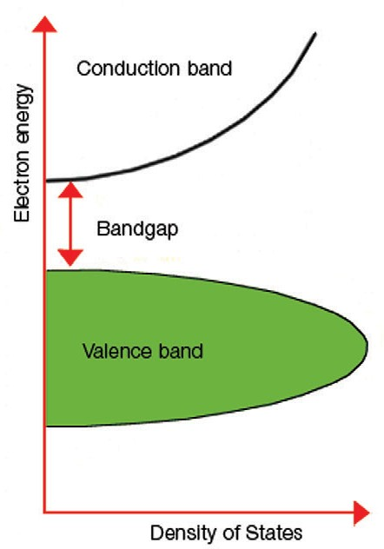
Determination of band gap by Uv-Vis spectroscopy
The measurement of the band gap of materials is important in the semiconductor, nanomaterial and solar industries. This note demonstrates how the band gap of a material can be determined from its UV absorption spectrum.

Slide 3
Determination of band gap by Uv-Vis spectroscopy
The term “band gap” refers to the energy difference between the top of the valence band to the bottom of the conduction band (See Figure 1); electrons are able to jump from one band to another.
In order for an electron to jump from a valence band to a conduction band, it requires a specific minimum amount of energy for the transition, the band gap energy.

Slide 4
Determination of band gap by Uv-Vis spectroscopy
A diagram illustrating the band gap is shown in Figure
Measuring the band gap is important in the semiconductor and nanomaterial industries.
The band gap energy of insulators is large (> 4eV), but lower for semiconductors (< 3eV).
The band gap properties of a semiconductor can be controlled by using different semiconductor alloys such as GaAlAs, InGaAs, and InAlAs

Slide 5
Tauc plot
A Tauc plot is used to determine the optical band gap, or Tauc gap, in semiconductors.
The Tauc gap is often used to characterize practical optical properties of amorphous materials. While investigating the optical and electronic properties of amorphous germanium, Tauc et al, proposed and substantiated a method for determining the band gap using optical absorbance data plotted appropriately with respect to energy.

Slide 6
Tauc plot
This was further developed in Davis and Mott’s more general work on amorphous semiconductors. They show that the optical absorption strength depends on the difference between the photon energy and the band gap as shown in (Eq. 1):
(𝛼ℎ𝑣)^{1/𝑛} = 𝐴(ℎ𝑣 − 𝐸𝑔) (1)
where h is Planck’s constant, ν is the photon’s frequency, α is the absorption coefficient, E_{g} is the band gap and A is a proportionality constant.

Slide 7
Tauc plot
The value of the exponent denotes the nature of the electronic transition, whether allowed or forbidden and whether direct or indirect:
For direct allowed transitions n=1/2
For direct forbidden transitions n=3/2
For indirect allowed transitions n=2

Slide 8
Tauc plot
For indirect forbidden transitions n=3
Typically, the allowed transitions dominate the basic absorption processes, giving either n=1/2 or n=2, for direct and indirect transitions, respectively.
The resulting plot has a distinct linear regime which denotes the onset of absorption. Thus, extrapolating this linear region to the abscissa yields the energy of the optical band gap of the material.

Slide 9
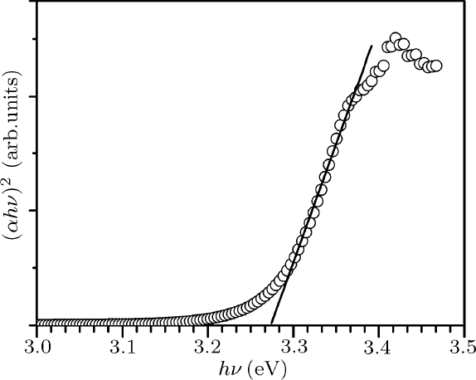
Figure 2: Example Tauc Plot from UV-Vis analysis of a ZnO thin film that illustrates the method of fitting the linear region to evaluate the band-gap at the X-axis intercept, here about 3.27 eV

Slide 10

Tauc plot
Figure 2 gives one example Tauc plot for ZnO where the absorption coefficient times the photon energy to the second power is plotted versus the incident photon energy.
The second power was used as zinc oxide is well known to have a direct allowed transition.
The characteristic features of Tauc plots are evident:
at low photon energies the absorption approaches zero – the material is transparent;

Slide 11
Tauc plot
near the band gap value the absorption gets stronger and shows a region of linearity in this squared-exponent plot.
This linear region has been used to extrapolate to the X-axis intercept to find the band gap value (here about 3.27 eV).
At even higher energies the absorption processes saturate and the curve again deviates from linear.

Slide 12
Tauc plot
To select and justify a linear region for extrapolation one must understand the reasons for these lower and upper deviations from linear behavior.
On the low energy end, the deviation from linearity can be associated with defect absorption states that are near the band edge. This phenomenon has been investigated by Urbach and in subsequent years, therefore, identified as an “Urbach Tail.”

Slide 13
Tauc plot
These states are usually described by an exponential function, corresponding to a typical distribution of density of states, evident in the absorption behavior seen in the example Tauc plot (Figure 2).
On the high energy end, saturation of available transition states is responsible for a leveling out of absorption strength in most collected spectra

Slide 14
Concept of Photoluminescence
Luminescence is an electromagnetic (EM) radiation phenomenon due to excessive thermal radiation or incandescence in physical system.
With regard to luminescent semiconductors, when energy of incident photon is equal or beyond the energy band gap, it will excite the electron of valence band into conduction band through band gap.

Slide 15
Concept of Photoluminescence
Semiconductors generate recombination radiation from excited state to ground state.
Absorption will also happen when an electron is excited to higher energy level from neutral acceptor energy level and it can also transit to ionization donor energy level from valence band or transit to conduction band from ionization acceptor energy level. Those phenomena can explain the energy band or impurities in the semiconductor successfully.

Slide 16
Concept of Photoluminescence
Photoluminescence which inspects optical property of luminescent semiconductor materials is a strong and nondestructive technology.
According to analytic data of photoluminescence, we can know the kind of impurities, band gap, and impurity activation energy from the spectra.
We can estimate the composition of the compound from the peak intensity of PL spectra.
Using photoluminescence can investigate the internal interface of hetero-structure that general physical or electronic measurements can not measure.

Slide 17
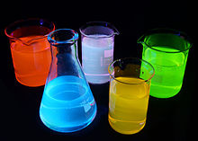
Concept of Photoluminescence
Fluorescent solutions under UV-light. Absorbed photons are rapidly re-emitted under longer electromagnetic wavelengths.

Slide 18
Concept of Photoluminescence
Luminescence of semiconductors can divide two types:
(1) Radiative transition
When an electron drops to lower energy state from higher energy state, it will probably occur radiative transition regardless of intrinsic state or energy state formed by impurities. Therefore, the system is not a balanceable condition and we assume that excited phenomena will generate electron-hole pairs in semiconductors. Firstly, we consider some basic transitions:
  (a)Band-to-band transition:
Band-to-band transition is the relationship of free-electrons and holes. Those transitions usually occur in direct band gap materials such as Ⅲ-Ⅴcompounds where the electron-hole pairs will generate radiation recombination effectively between conduction band and valence band.
18PYB101J Module-IV Lecture-15

Slide 19
Concept of Photoluminescence
  (b)Free exciton transition
If the material is very pure, an electron and a hole will attract each other to form exciton. Then, they will recombine to generate a very narrow spectrum. In Ⅲ-Ⅴ compounds, free exciton energy state usually describes Wannier-Mott approximation. The energy of free exciton can be expressed as Equation 1.
E_{n} =2π ²m*e⁴ /h²ε²n² ⁽¹⁾
In this equation, m* is effective mass, h is Planck constant, ε is dielectric constant, and n is quantum number.
However, there are probably several mechanisms to result in non-radiative transition. Those transitions will compete with radiative transition to result in lower luminescence.
18PYB101J Module-IV Lecture-15

Slide 20
Concept of Photoluminescence
  (c)Free-to-bound transition
The transition is free-to-bound transition between energy bands of materials and impurity energy level. This transition is between the impurity and one of energy bands such as from conduction band to acceptor or from donor to valence band. The energy of radiative photon is E_{g}-E_{b} and E_{b} is bound energy of shallow impurity energy level.
  (d)Donor-acceptor pair recombination
  The transition is between donor and acceptor. After optical pumping, the electrons and holes will be bounded at D+ and A- locations to generate neutral D₀ and A₀ centers. Some neutral donor electrons will recombine with neutral acceptor holes radiatively.
18PYB101J Module-IV Lecture-15

Slide 21
Concept of Photoluminescence
Non-radiative transition
Some opportunities which cause non-radiative transition will compete with radiative recombination transition and influence luminescent efficiency negatively. They can describe as below:
  Because of thermal oscillation to generate phonons;
  Recombination on the surface state includes two dimensional dislocation, and agglomerative boundary through step-wise transition which causes loss of energy. It also calls cascade process;
  Impurity locations are often not radiative recombination centers;
  Loss of energy of trapped carriers will excite other carriers in the lattice and emit non-radiative loss energy by Auger process.
18PYB101J Module-IV Lecture-15

Slide 22


